Slide 1
Instagram User Analytics

Slide 2
agenda
1 . Project Description
2. Approach
3. Tech-Stack Used
4. Insights
5. Result

Slide 3
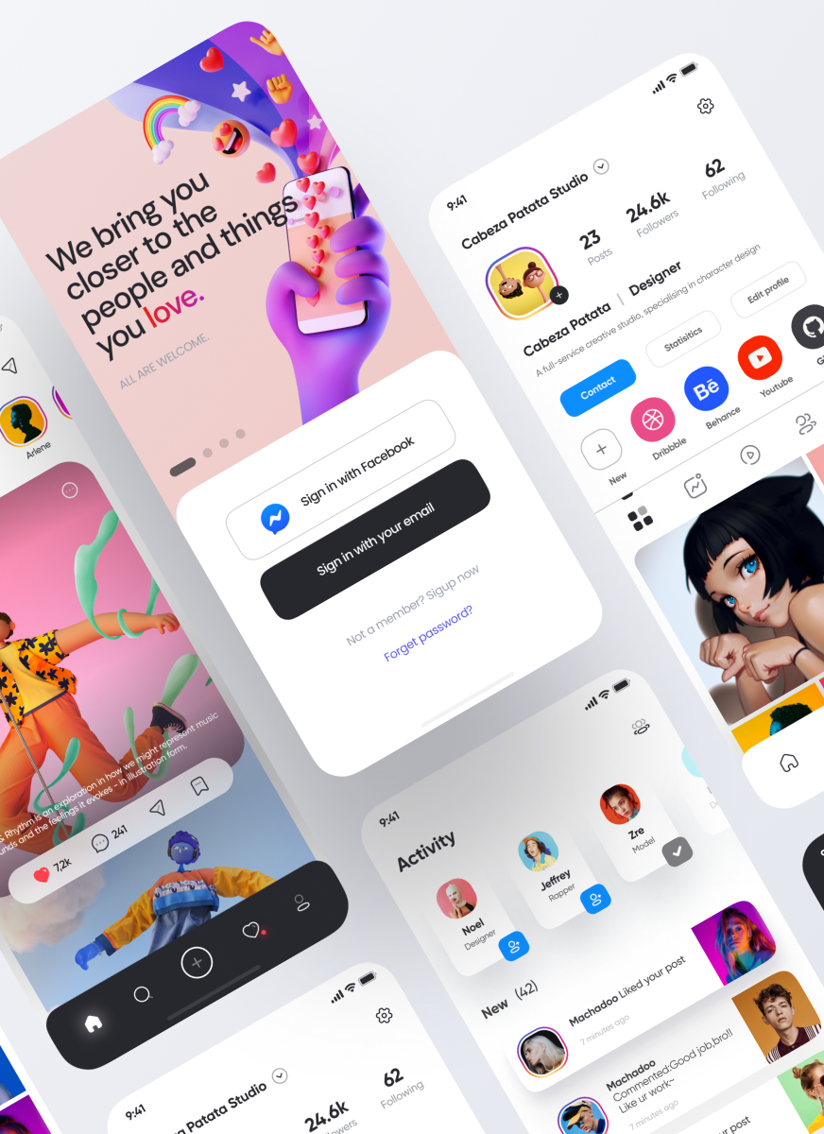
Project Description
The objective of this project is to evaluate Instagram app users’ interactions and engagement using SQL and MySQL Workbench.
It helps provide useful insights for the product team of Instagram, hence enabling them to make informed choices on the future path of the app.
The purpose of this project is to leverage SQL skills to analyze user interactions and engagement with the Instagram app.
By extracting meaningful insights from the provided database, we aim to assist the product team in making informed decisions to enhance the Instagram platform's user experience and drive business growth

Slide 4
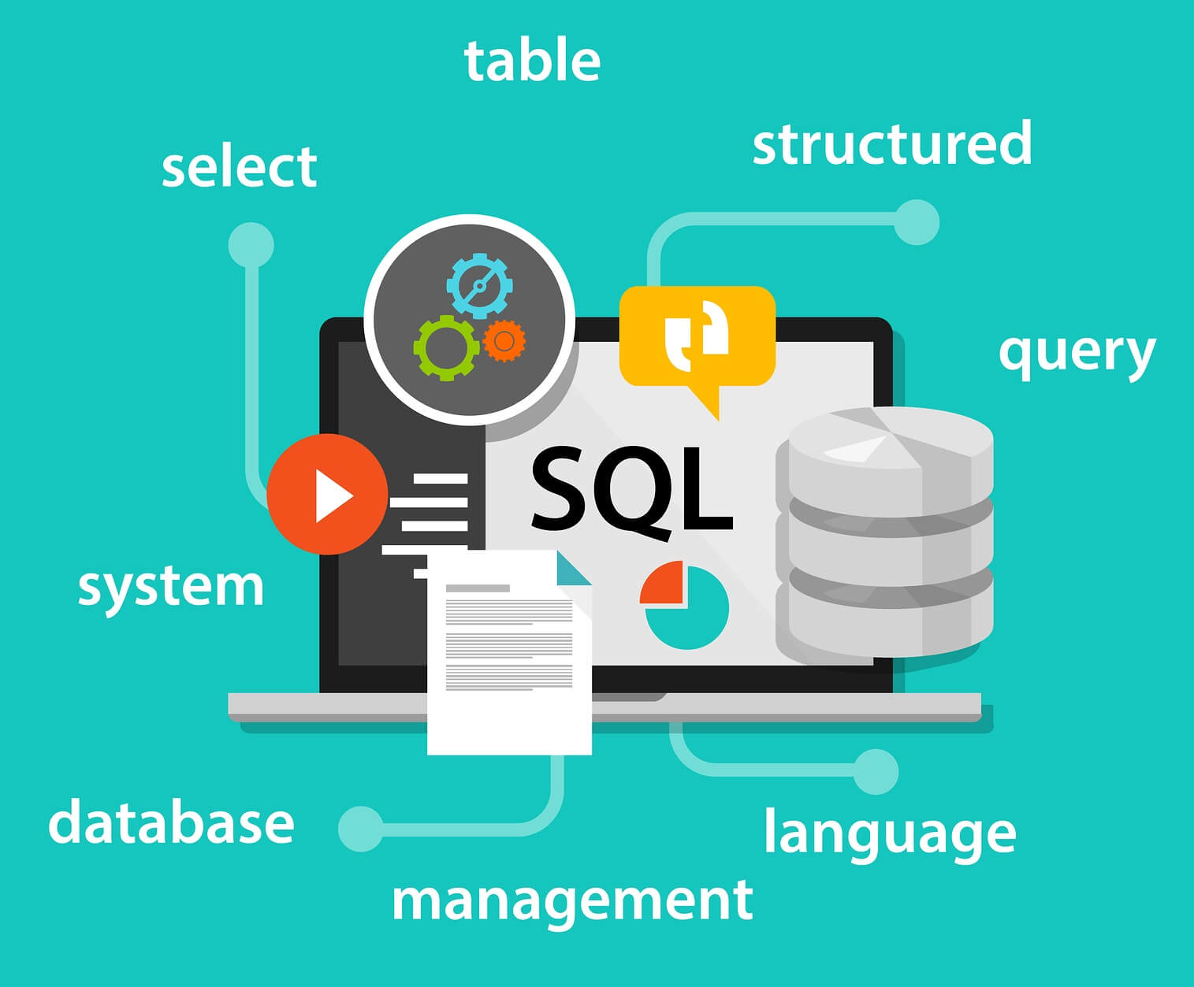
Approach
1. Understanding the Data : Initially, I decided to examine the structure and content of the database that was provided, using MySQL Workbench in particular. This included looking at tables, columns and how they relate to each other with an aim of getting clear understanding of what data is available.
2. Formulating SQL Queries : Afterwards, I created tailored SQL queries for every specific question from the management team. These were meant to pull out needed information from the database concerning user behavior questions, engagement metrics and other key performance indicators.

Slide 5
3. Executing Queries : Then I executed SQL queries on the database through MySQL Workbench for which accuracy and efficiency were ensured during extraction process taking into account all necessary joins, aggregations or conditions required. 4. Analyzing Results : Next after running queries; meaningful insights could be drawn if results are analyzed well enough. This involved examining data to observe patterns, trends, or irregularities in Instagram users’ interaction rates. 5. Preparing Insights Report : Lastly, I summarized my main findings and insights into a report format. The report outlined major insights as well as recommendations and actionable strategies for product team based on Instagram analysis done . This report served as a reference point for decision-making processes and future development efforts.
Overall, my approach involved a systematic and structured analysis of the Instagram user data using SQL queries, followed by the preparation of actionable insights to guide the product team's decision-making processes.

Slide 6
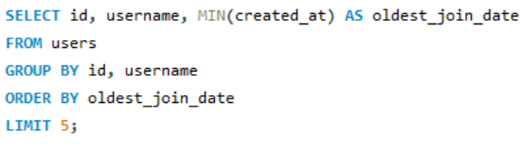
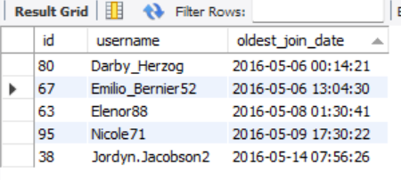
Code and Outputs
QUESTION 1 : Loyal User Reward: The marketing team wants to reward the most loyal users, i.e., those who have been using the platform for the longest time. Your Task: Identify the five oldest users on Instagram from the provided database.
QUESTION 2 : Inactive User Engagement: The team wants to encourage inactive users to start posting by sending them promotional emails. Your Task: Identify users who have never posted a single photo on Instagram

Slide 7

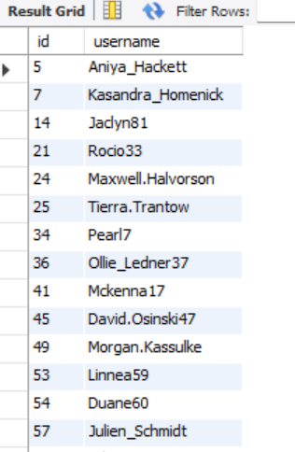
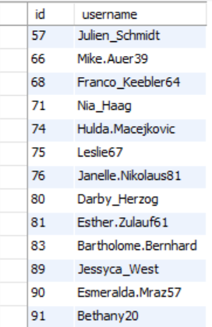

Slide 8
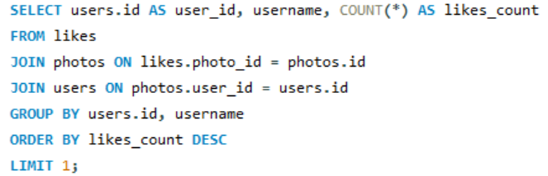
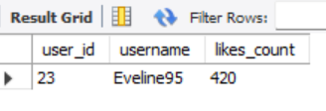
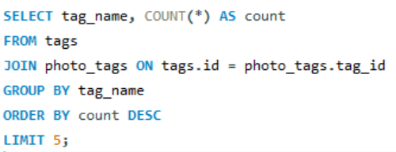
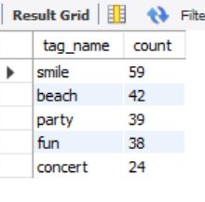
QUESTION 3 : Contest Winner Declaration: The team has organized a contest where the user with the most likes on a single photo wins. Your Task: Determine the winner of the contest and provide their details to the team.
QUESTION 4 : Hashtag Research: A partner brand wants to know the most popular hashtags to use in their posts to reach the most people.
Your Task: Identify and suggest the top five most commonly used hashtags on the platform.

Slide 9
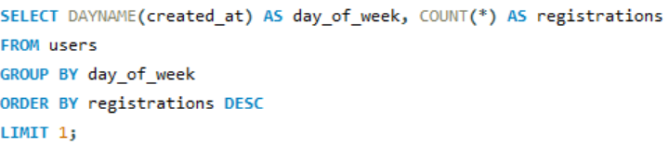

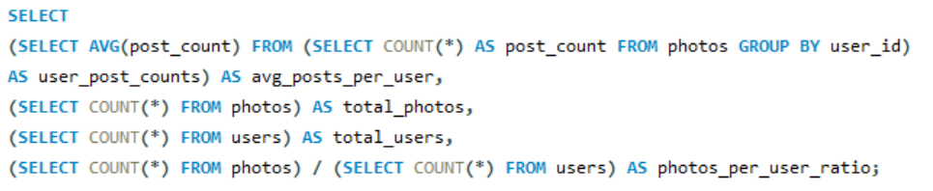

QUESTION 5 : Ad Campaign Launch: The team wants to know the best day of the week to launch ads. Your Task: Determine the day of the week when most users register on Instagram. Provide insights on when to schedule an ad campaign.
QUESTION 6 : User Engagement: Investors want to know if users are still active and posting on Instagram or if they are making fewer posts.
Your Task: Calculate the average number of posts per user on Instagram. Also, provide the total number of photos on Instagram divided by the total number of users.

Slide 10
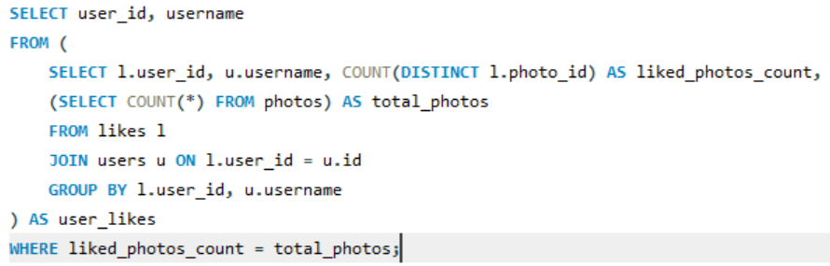
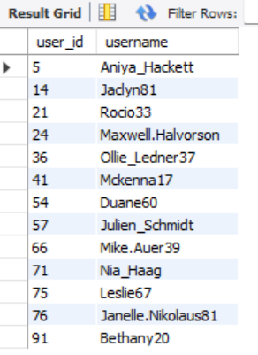
QUESTION 7 : Bots & Fake Accounts: Investors want to know if the platform is crowded with fake and dummy accounts.
Your Task: Identify users (potential bots) who have liked every single photo on the site, as this is not typically possible for a normal user.

Slide 11
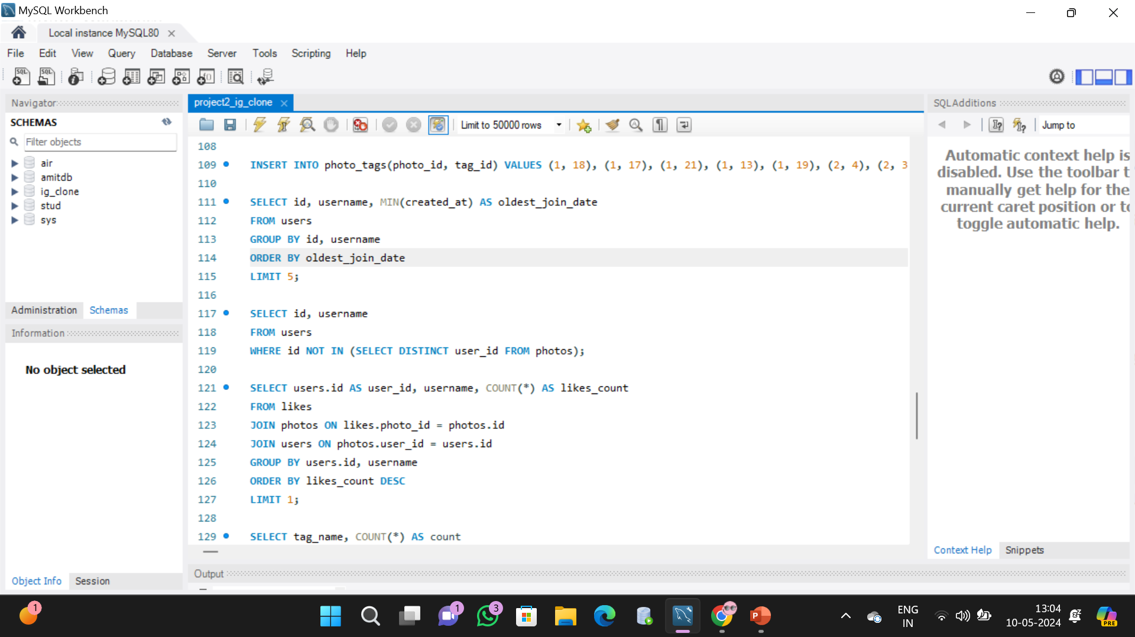
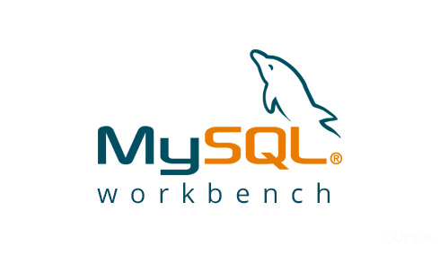
Tech-Stack Used
For this project, I primarily used MySQL Workbench, a comprehensive tool tailored for MySQL database management and SQL querying.
Its user-friendly interface and robust features, including SQL development, database design, and schema visualization, made it an ideal choice for handling tasks such as data analysis and query execution.
MySQL Workbench's efficiency in writing and executing SQL queries, along with its database management capabilities, facilitated a smooth workflow in understanding the database structure, formulating queries, and deriving insights from the Instagram user data.
Overall, MySQL Workbench proved to be a reliable and efficient tool for the project's requirements.

Slide 12
Insights
Through my research and analysis of Instagram user data, several key insights have emerged:
User Engagement Dynamics : The data revealed diverse patterns of user engagement, showcasing varying levels of activity across different user segments. This insight underscores the importance of understanding user behavior to tailor strategies that resonate with distinct audience segments.
- Eveline is the winner of the contest.
Recognition of Loyal Users : Identifying users who have been with the platform for an extended period sheds light on the significance of acknowledging and rewarding loyalty. Such insights emphasize the need for cultivating strong relationships with devoted users to foster brand advocacy and long-term retention.
- Darby , emilio , Elenor , Nicole , Jordyn are the most loyal users .
Segmentation of Inactive Users : The identification of users who have never posted unveils opportunities for targeted re-engagement initiatives. Understanding the reasons behind user inactivity can inform personalized outreach efforts aimed at reigniting user interest and preventing attrition.
- Aniya , jaydn , mike ,nia ,etc haven’t posted any photos so far .
Insight into Content Trends : Analysis of popular hashtags offers valuable insights into emerging content trends and user interests. These findings can guide content creation strategies and partnerships with brands seeking to align with trending topics and themes.
- smile ,beach , party ,fun ,concert are the most used hastags .

Slide 13
Strategic Ad Campaign Timing : By pinpointing peak registration times, the research highlights optimal windows for launching ad campaigns to maximize visibility and user acquisition. Aligning marketing efforts with periods of heightened user activity can amplify campaign effectiveness and ROI.
- Thursday is the day when most users register on Instagram and best day to schedule a campaign.
Detection of Suspicious Accounts : The identification of users exhibiting behavior indicative of potential bots or fake accounts underscores the importance of maintaining platform integrity. Addressing such accounts is crucial for safeguarding user trust and preserving the authenticity of user interactions.
- Aniya , Jadyn , ollie , Rocio , etc are some of the bot & fake accounts.
Understanding User Content Creation Habits : Calculating the average number of posts per user provides insights into user-generated content trends and engagement levels. This understanding can inform content moderation strategies and platform enhancements aimed at fostering a vibrant and engaging user community.
- Avg_posts per user : 3.4730 and photos_per_user ratio : 2.5700
In conclusion, these research findings offer actionable insights that can inform strategic decision-making processes, drive user engagement initiatives, and contribute to the continued growth and success of the Instagram platform.

Slide 14
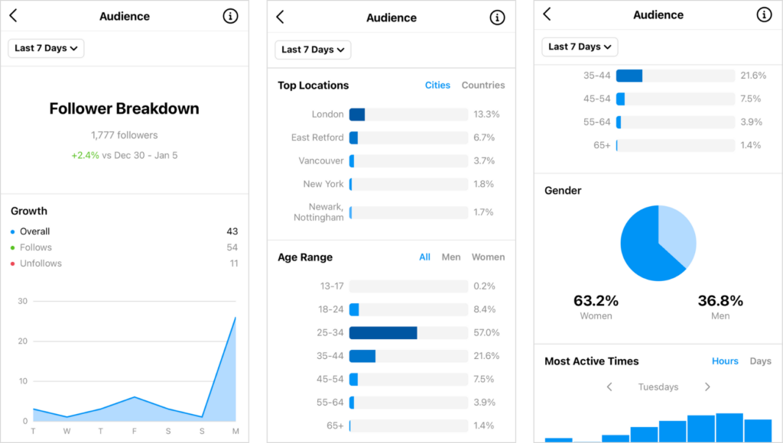
Results
Through this project, I successfully extracted meaningful insights from Instagram user data, which can guide decision-making processes for the product team. The analysis provides actionable information for rewarding loyal users, engaging inactive users, conducting contests, optimizing hashtag usage, and scheduling ad campaigns. These insights can contribute to the growth and improvement of Instagram as a leading social media platform. These findings are gold for the product team, giving them the ammo they need to make smart decisions. From identifying the oldest users for rewards to figuring out how to wake up those silent users, and even determining who won a contest based on likes – it's all there. Plus, we've got some killer intel on the top hashtags and the best days to drop those ads. This stuff isn't just interesting; it's the key to leveling up Instagram and keeping it at the top of the social media game.

Slide 15
Thank you
Done by :Varunika naini
Email : varunikaanaini@gmail.com
Note : SQL file with queries has been attached to the drive link as reference

